Slide 1
United Airlines
Data Science Task
Subir Verma
Data Scientist

Slide 2
CONTENTS
Problem Statement
Modelling Objective: Regression
Exploratory Data Analysis
Data trends
Data Preprocessing
Regression Model
GridSearch and Parameter Tuning
Model Summary
Model Ensembling

Slide 3
Problem Statement
Problem statement: Predict total fare for each flight for carriers L1, L2 and L3 on a given day.
Data Set Information:
Data Set | Rows | Columns
train_fares | 1493689 | 9
train_schedules | 35374 | 9
service_index | 11546 | 7

Slide 4
Modelling Objective: Regression
MODELS USED
Random Forest Regressor
CatBoost Regressor
LightGBM Regressor
We will ensemble all the models to see the improvement

Slide 5
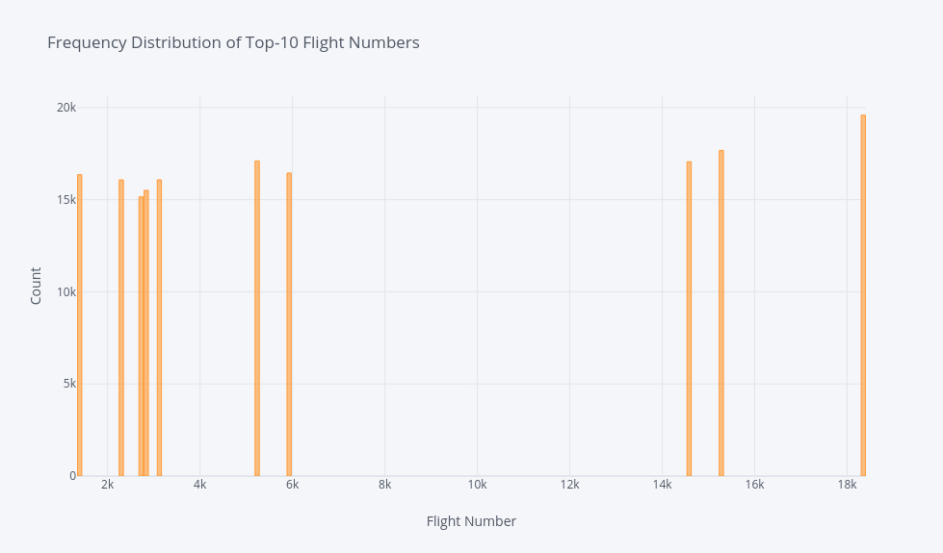
Exploratory Data Analysis (EDA)
Flight | Count
18349 | 19586
15278 | 17672
5236 | 17104
14581 | 17060
5927 | 16447
1396 | 16359
3120 | 16076
2297 | 16074
2837 | 15506
2724 | 15153
Top 10 flights during the year

Slide 6
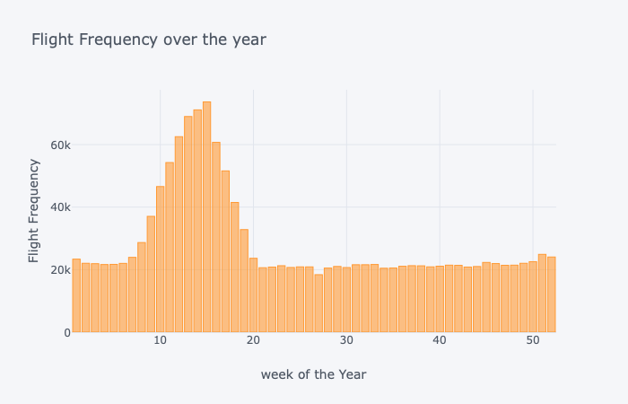
BUSIEST WEEK DURING THE YEAR

Slide 7
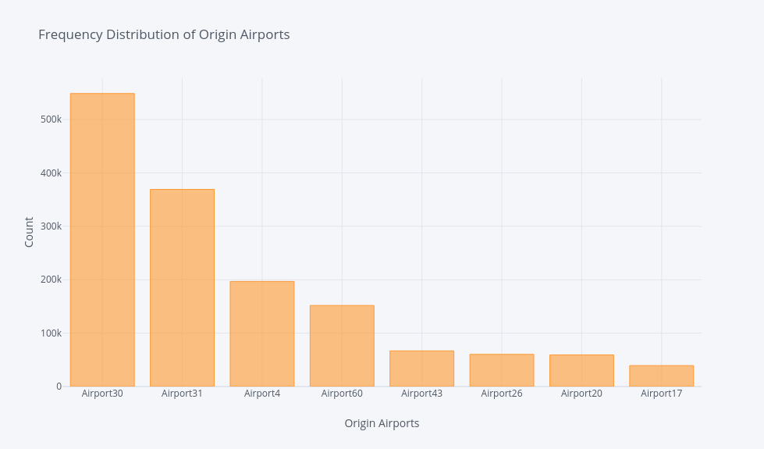
BUSIEST AIRPORTS

Slide 8
Data Pre-processing
Feature Engineering
Converting Date columns into Datetime Objects
One-hot Encoding Categorical Variables
Flight_travel_duration ( in hours).
Part of Day Calculation from gmt and local time.
Finding Day of year, weekday, week and quarter from from Observation Date and Flight Departure Date.

Slide 9
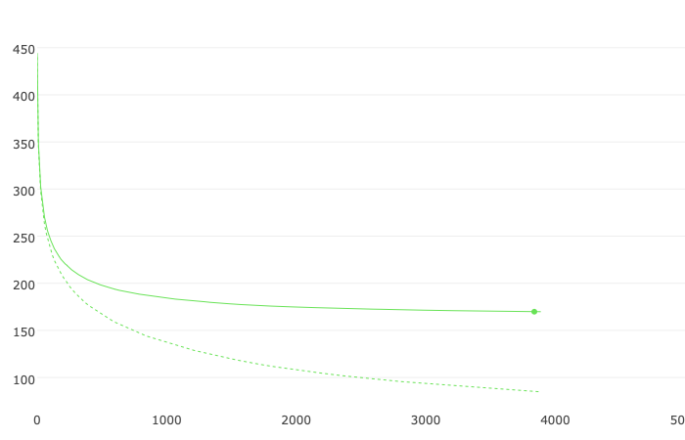
CatBoost
BENCHMARK MODEL
Parameters: Iterations=5000, learning_rate=0.5
Data Split: Train Shape 1342885 rows 60 columns
Test Shape 149210 rows 60 columns
Mean Absolute Error | Mean Squared Error | Root Mean Squared Error
112.73783946762764 | 42534.225545853944 | 206.23827371720785
Training Curve for Benchmark Model

Slide 10
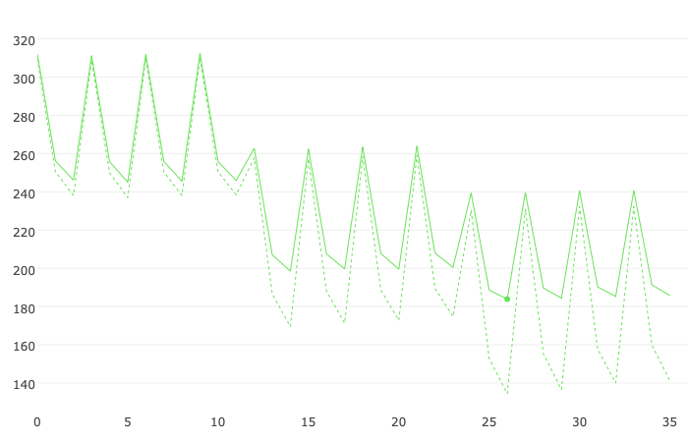
Grid Search: Parameter Tuning
CatBoost
Parameter Grid :
Learning_rate : [0.05, 0.3, 0.5],
Depth : [6, 10, 12],
L2_leaf_reg : [1, 1.5 , 2.5, 3]
Graph shows RMSE against different parameters
Optimized Parameters found Depth : 12 , l2_leaf_reg: 1 learning_rate: 0.5
Plot : ---- learn test

Slide 11
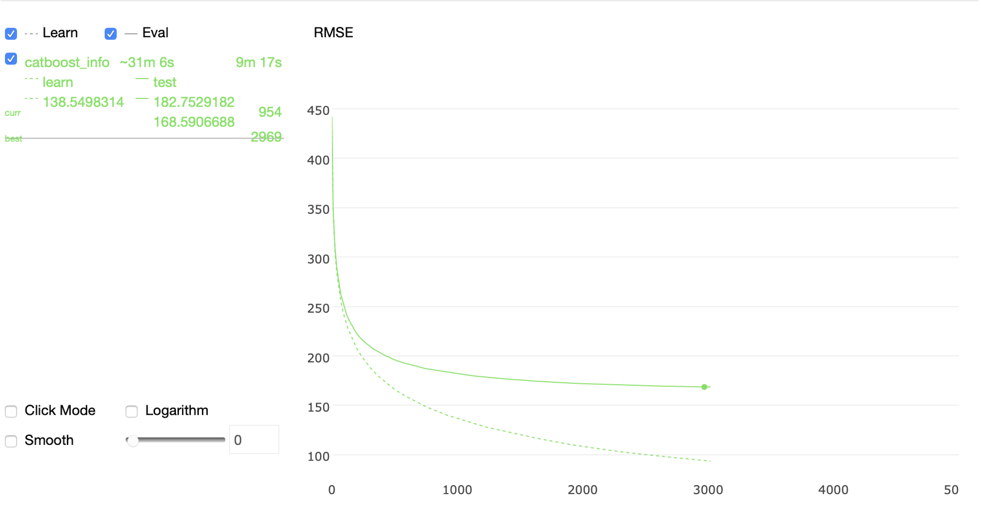
CatBoost: Training
Mean Absolute Error | 83.58818848626281
Mean Squared Error | 28422.813623058762
Root Mean Squared Error | 168.59066884931315
Note: Got improvement of 22.33% in RMSE from Benchmark.

Slide 12
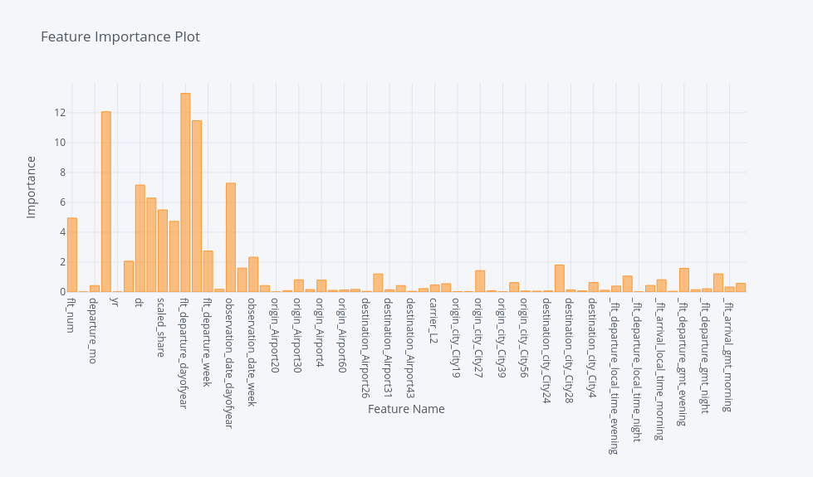
Feature Importance: Catboost

Slide 13
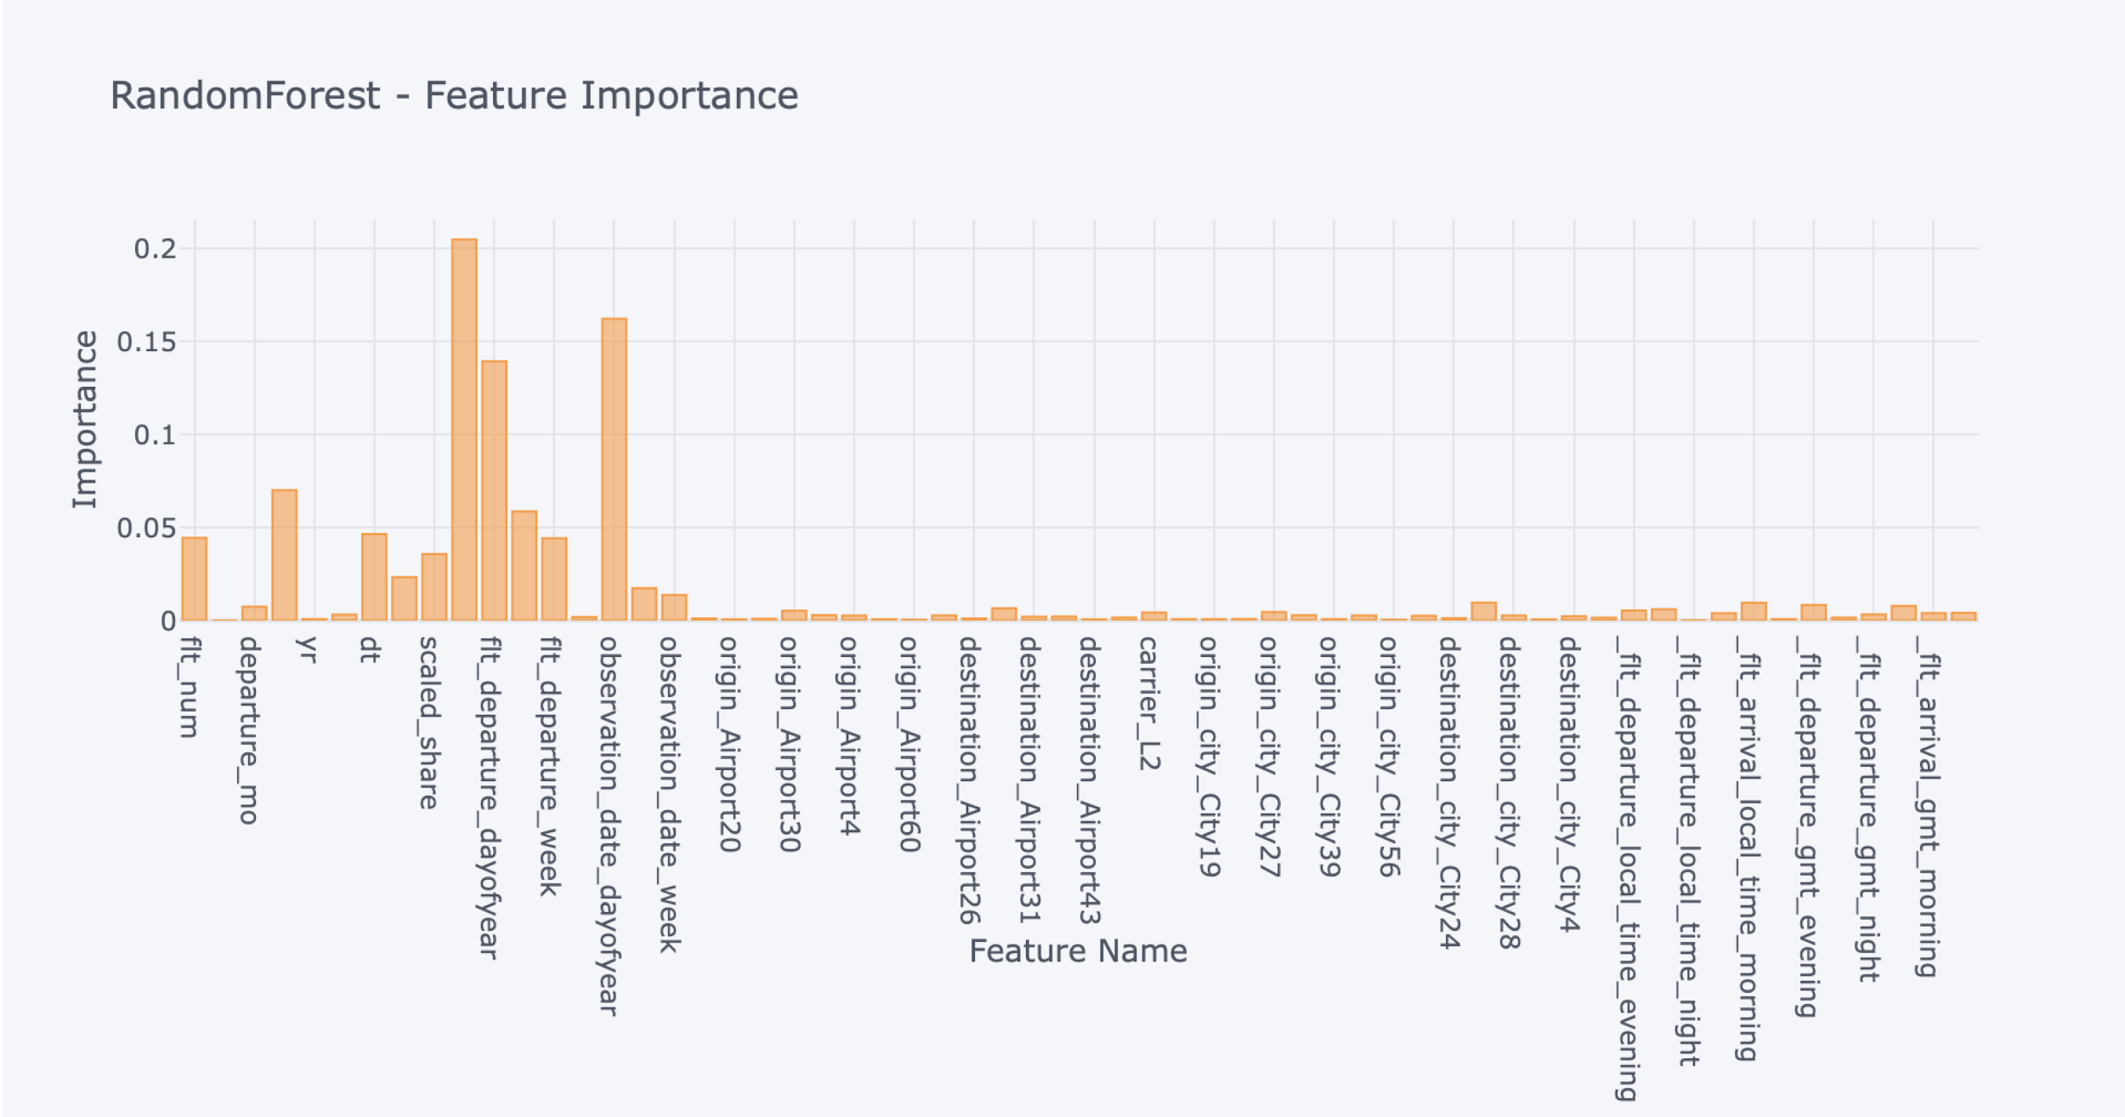
Random Forest: Model Training
Parameters:
n_estimators = 100
random_state = 42
Mean Absolute Error | 54.305118158433196
Mean Squared Error | 25137.295538932667
Root Mean Squared Error | 158.54745516384887
Note: Got improvement of 30.06% in RMSE from Benchmark.

Slide 14
LightGBM: Model Training
params = {'n_estimators': 15000,
'boosting_type': 'gbdt',
'objective': 'regression',
'metric': 'rmse',
'subsample': 0.8,
'subsample_freq': 1,
'learning_rate': 0.25,
'feature_fraction': 0.8,
'max_depth': 15,
'num_leaves': 200,
'lambda_l1': 10,
'lambda_l2': 10,
'early_stopping_rounds': 200,
'verbose': 1,
'random_seed': 42
}
Mean Absolute Error | 79.69120934645572
Mean Squared Error | 27742.522110634975
Root Mean Squared Error | 166.56086608394835
Note: Got improvement of 23.82% in RMSE from Benchmark.

Slide 15
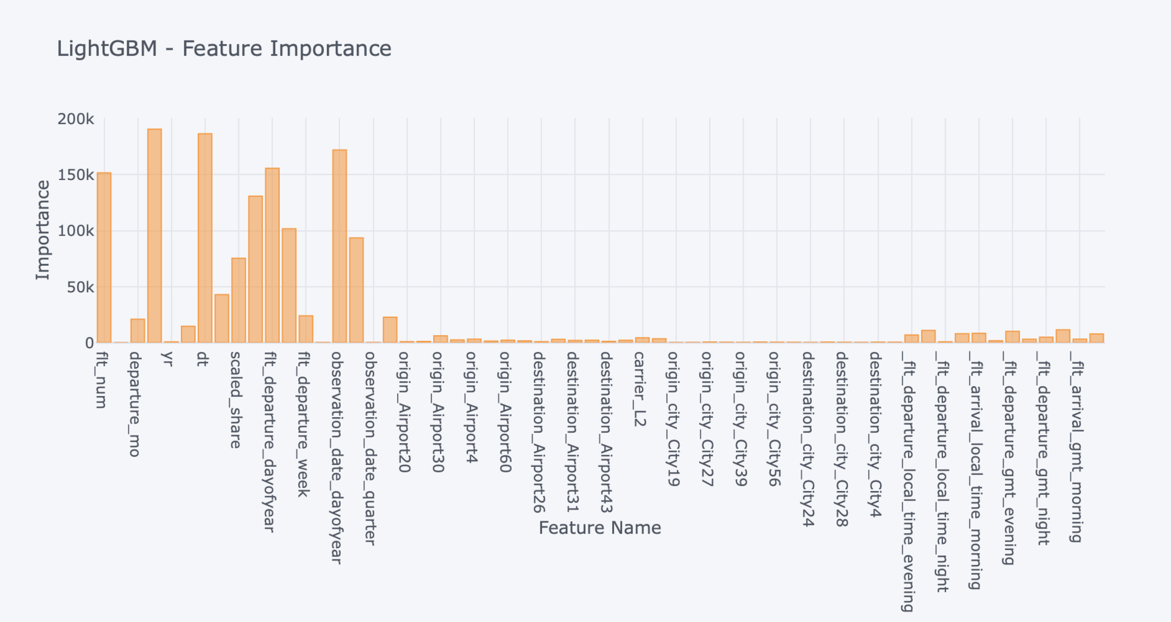
Feature Importance: LightGBM

Slide 16
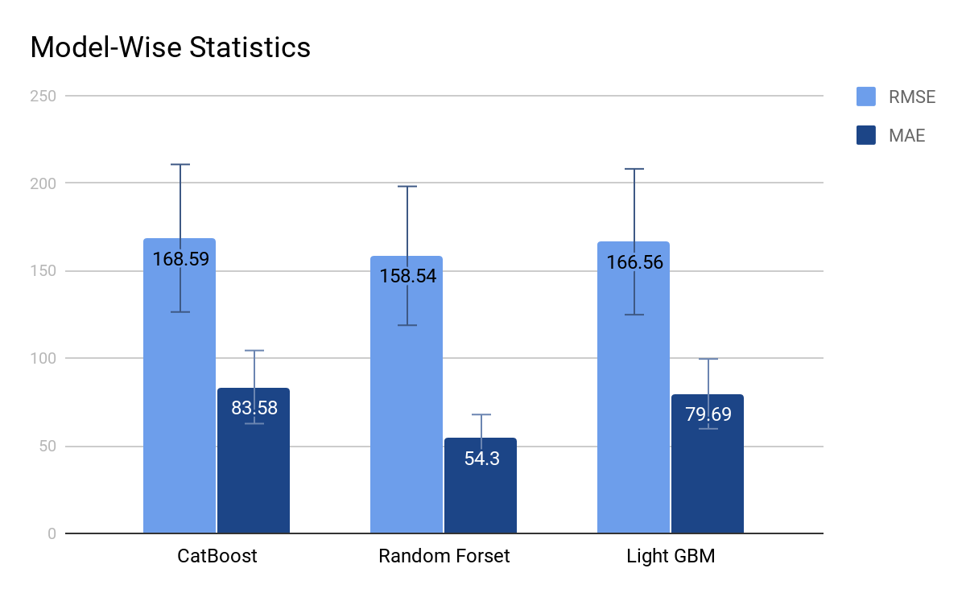
Model Summary

Slide 17
Model Ensembling
CatBoost
40%
MAE | 47.14
MSE | 8662.20
RMSE | 93.07
RandomForest
20%
40*CB+20*RF+40*LGB
Ensembling
LightGBM
40%

Slide 18
Summary
Flight Travel Duration Proved to be effective feature.
Day of Year has direct impact on the fare of flights.
Flight Number column should not be dropped. It contains information about the flight capacity and benefits which affects the total fares.
Get_part_of_day functions insights about the phase of day. Rush days/weeks combined with the feature will give the busiest durations.
Grid Search helped to find right parameters.
Weighted Ensembling of Bagging and Boosting Models improved the overall RMSE.

